Slide 1
Barcode Decoder

Slide 2
Processing Steps
1) Binarization
2) Edge detection
3) Line detection
4) Rotation
5) Binarization
6) Noise Reduction
7) Getting information
8) Recovery of BarCode

Slide 3

1.Original Image

Slide 4

2.Canny edge detection

Slide 5
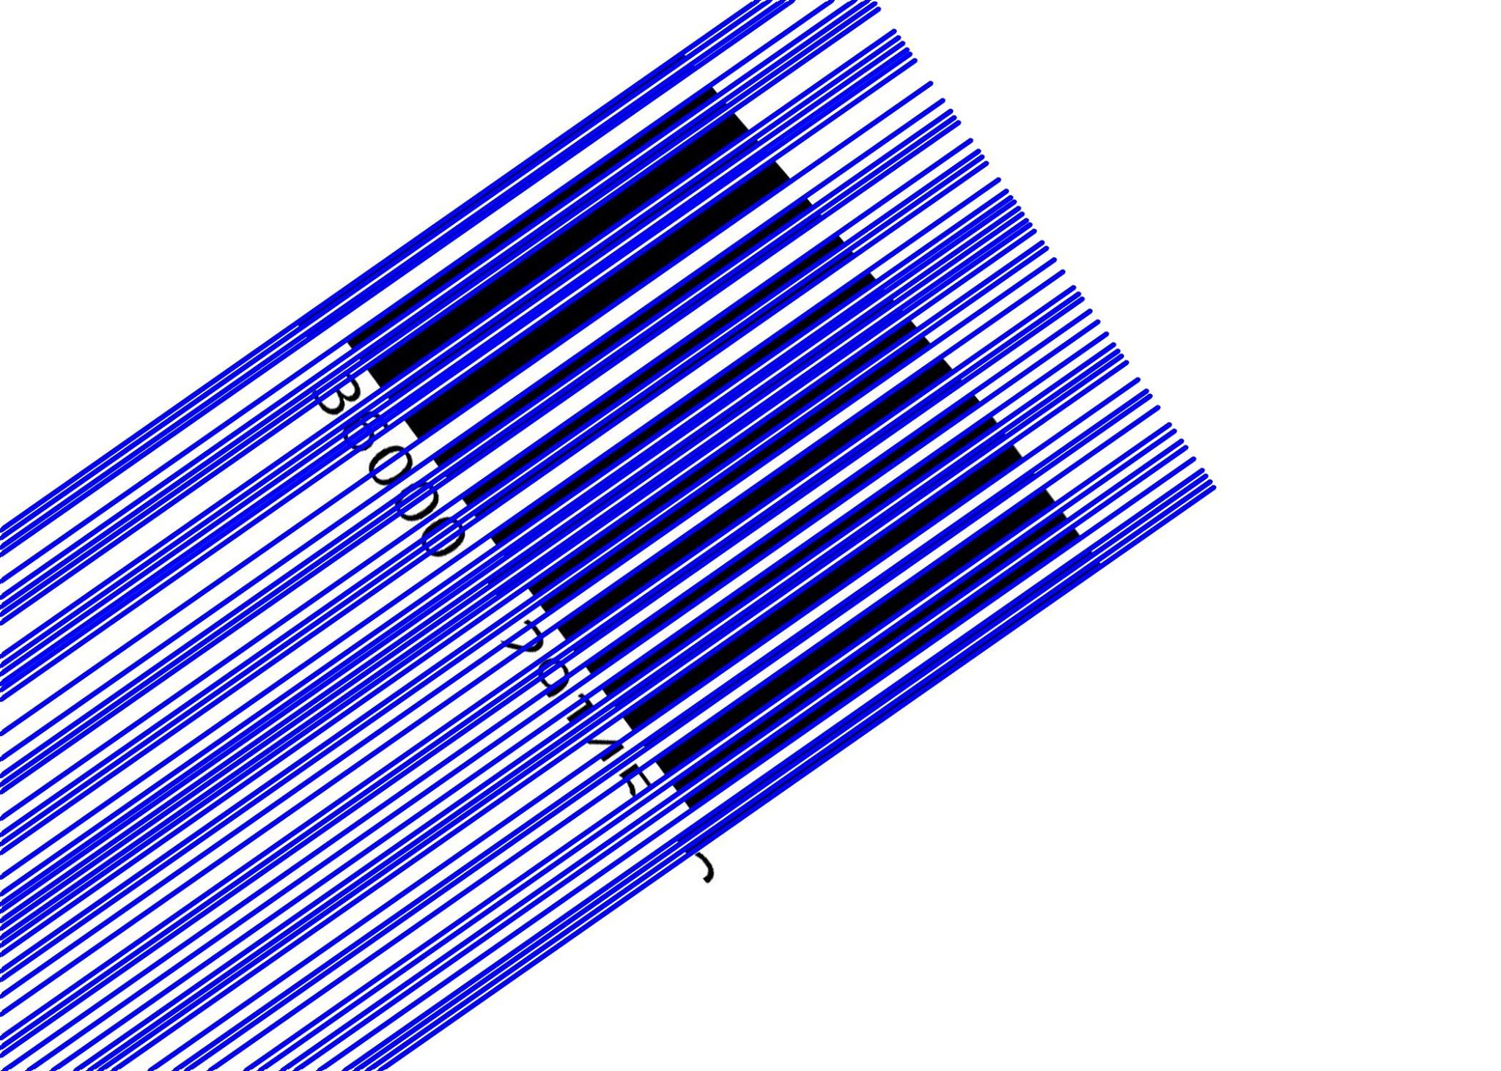
3.Line detection (Hough Transform)

Slide 6

4.Rotation
4. Image Rotation

Slide 7

5. Adaptive Binarization

Slide 8

6. Getting information and recovering

Slide 9
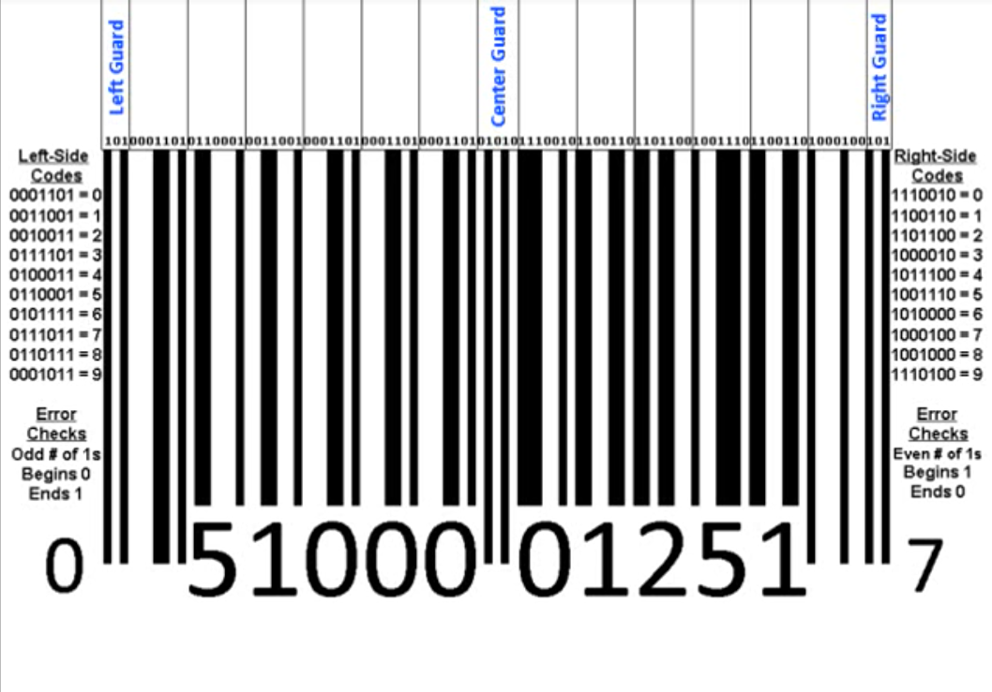
6. Getting information and recovering

